Slide 1

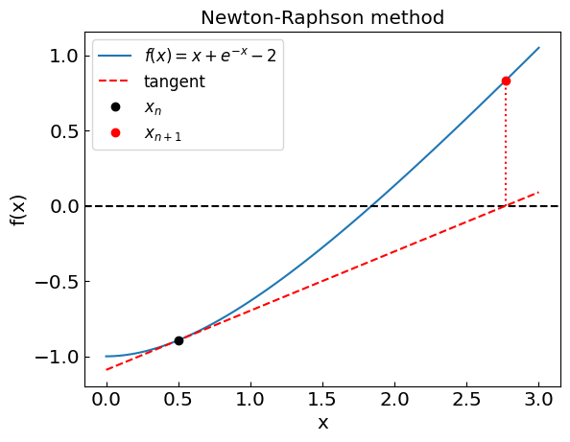
Computational Physics (PHYS6350)
Lecture 4: Non-linear equations and root-finding
January 24, 2023
Instructor: Volodymyr Vovchenko (vvovchenko@uh.edu)
Course materials: https://github.com/vlvovch/PHYS6350-ComputationalPhysics

Slide 2
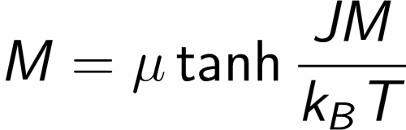
Non-linear equations
Suppose we have an equation f(x) = 0
We can evaluate f(x), but we do not know how to solve it for x
Examples:
Roots of high-order polynomials (e.g. Lagrange L₁ point)
Transcendental equations
e.g. magnetization equation
References:
Chapter 6 of Computational Physics by Mark Newman
Chapter 9 of Numerical Recipes Third Edition by W.H. Press et al.

Slide 3
Root-finding techniques
Numerical root-finding method: iterative process to determine the root(s) of non-linear equation(s) to desired accuracy
Types:
Two-point (bracketing)
Bisection method
False position method
Local
Secant method
Newton-Raphson method (using the derivative)
Relaxation method
Multi-dimensional
Newton method
Broyden method

Slide 4

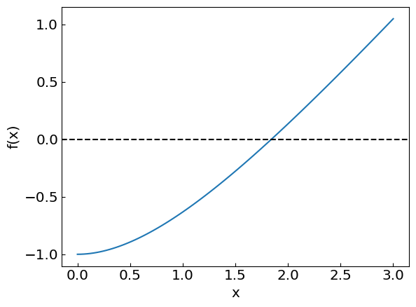
Non-linear equations
Consider an equation

Slide 5
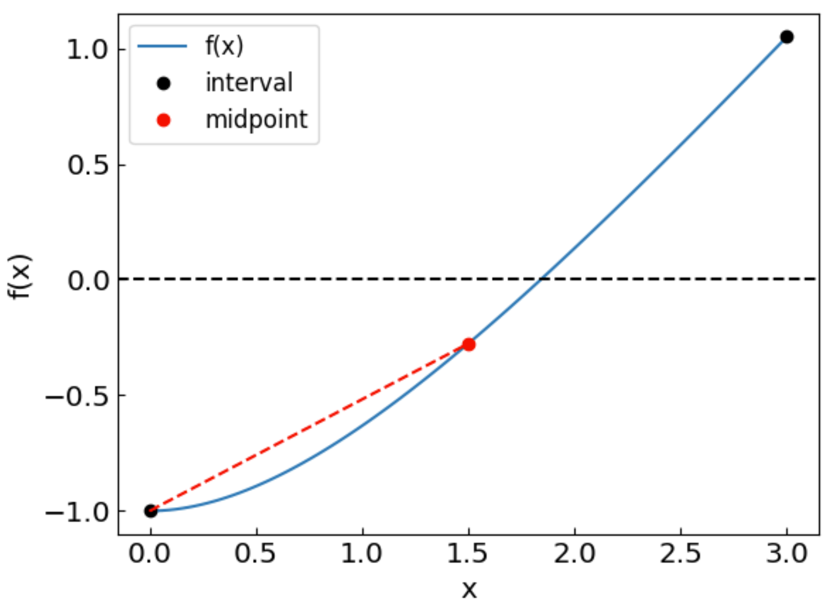
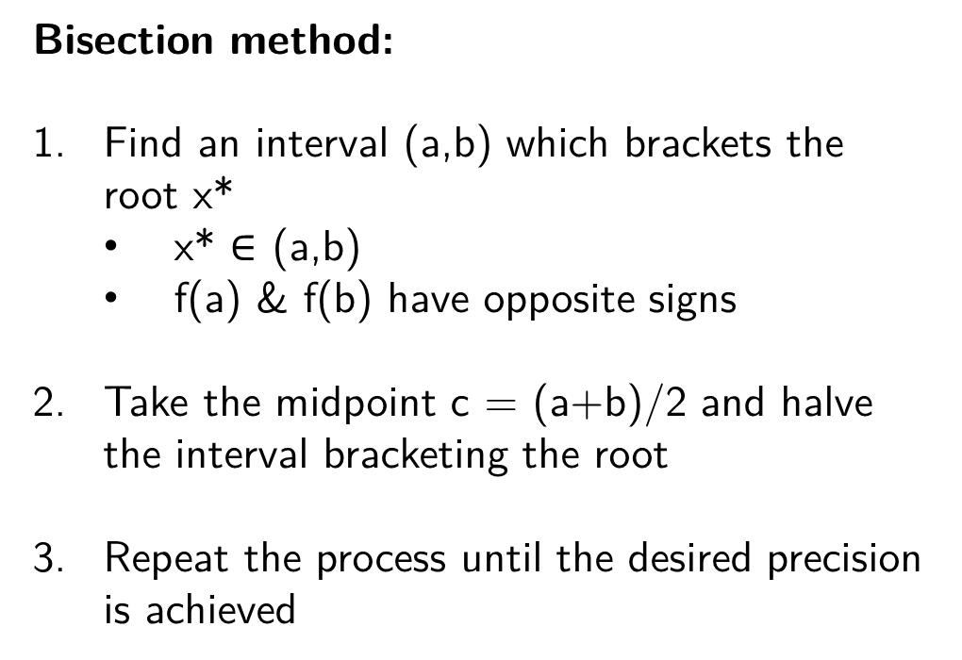
Bisection method
Bisection method:
Find an interval (a,b) which brackets the root x*
x* $∈$ (a,b)
f(a) & f(b) have opposite signs
Take the midpoint c = (a+b)/2 and halve the interval bracketing the root
Repeat the process until the desired precision is achieved
Method is guaranteed to converge to the root
The error is halved at each step – “linear” convergence

Slide 6
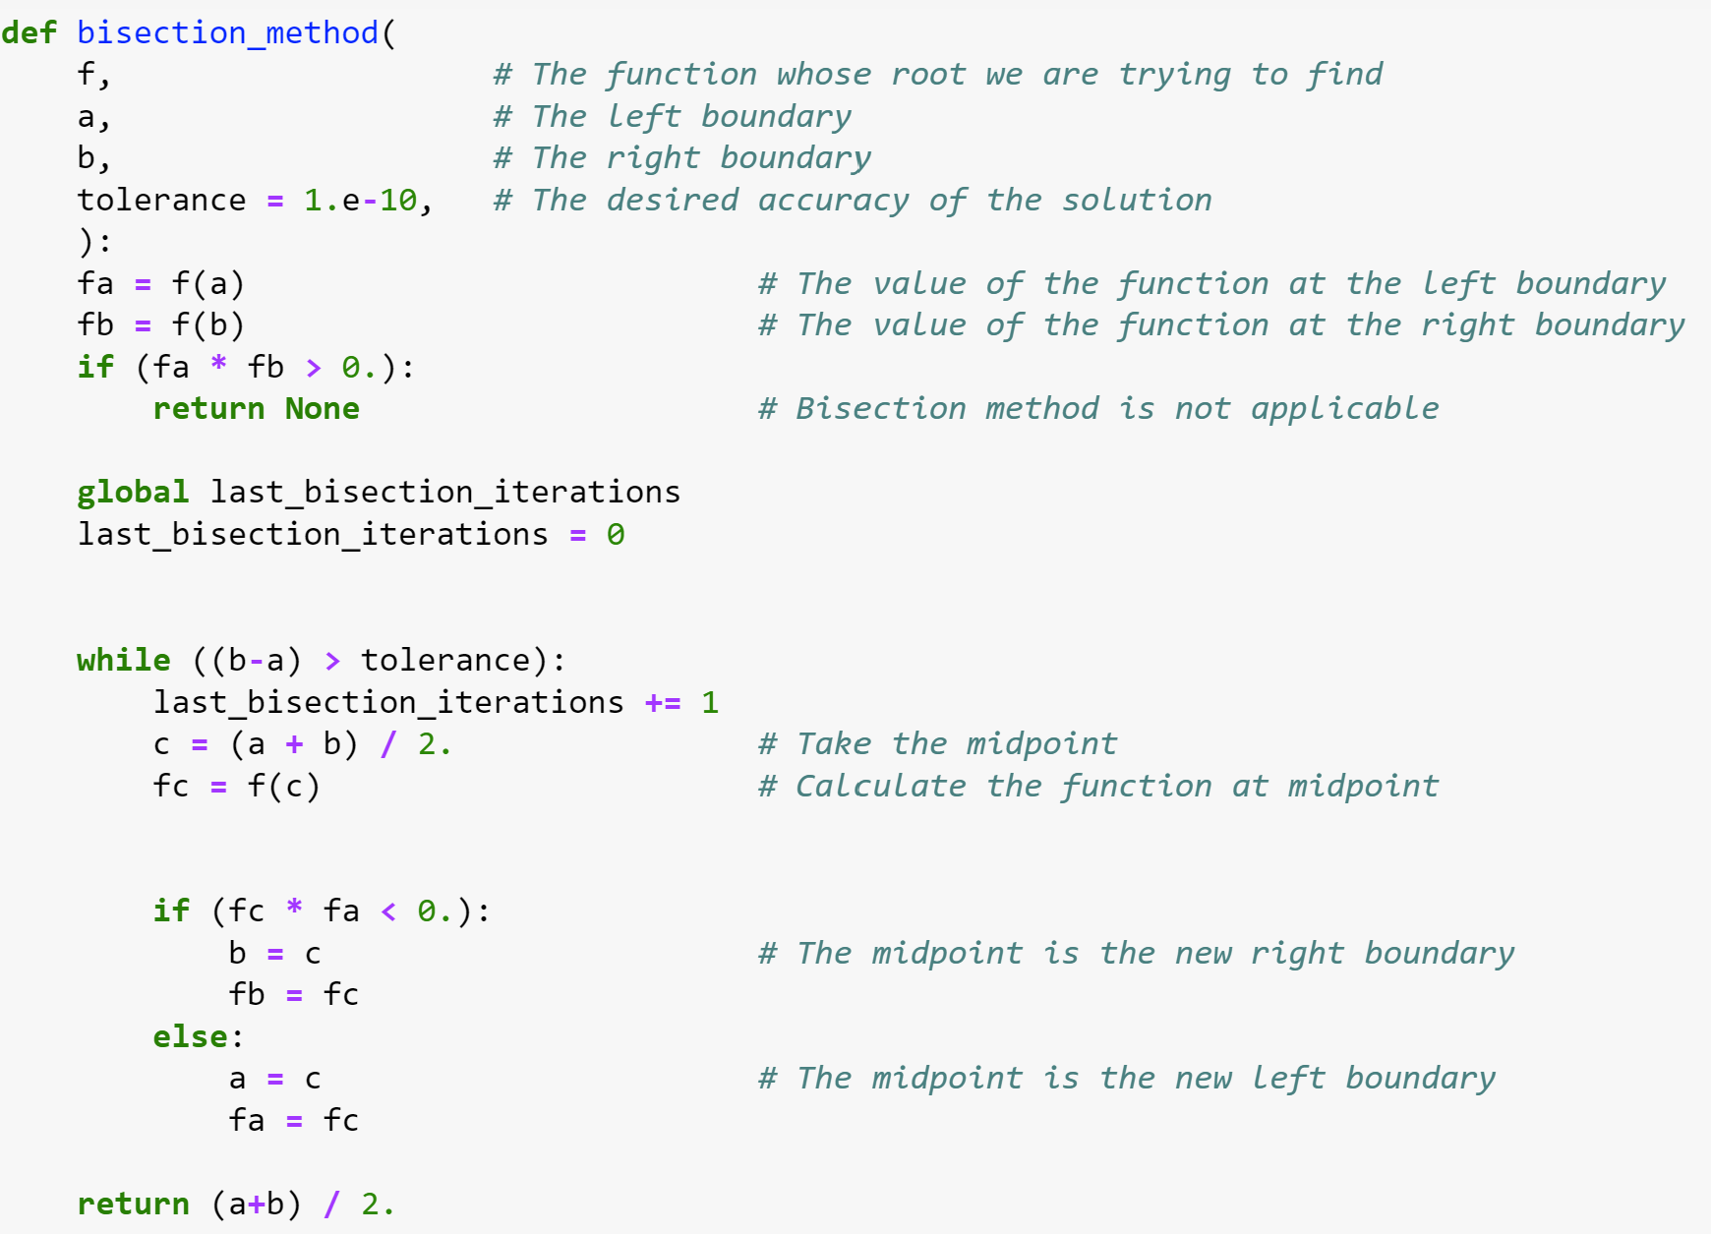
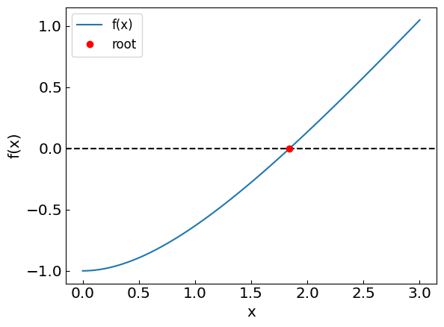
Bisection method

Slide 7
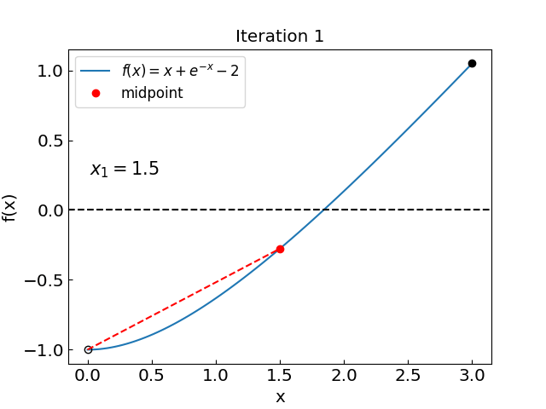
Bisection method: how the iterations look like

Slide 8
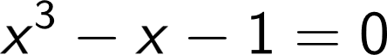
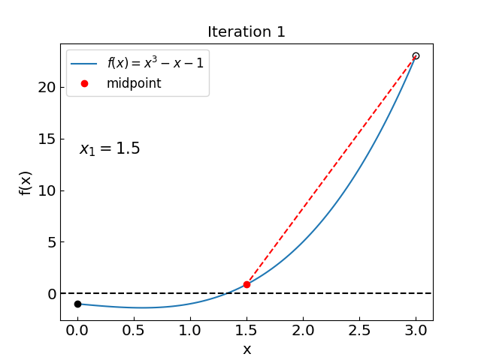
Bisection method: another
Let us consider another equation:
35 iterations in both cases

Slide 9
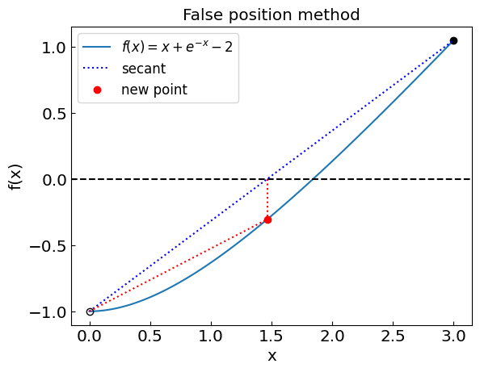
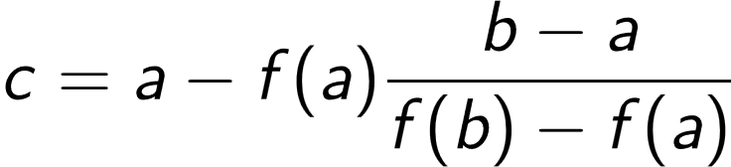
False position method
False position method:
Find an interval (a,b) which brackets the root x*, same bisection
Instead of midpoint take a point where the straight line between the endpoints crosses y = 0 axis
Repeat the process until the desired precision is achieved
Method is guaranteed to converge to the root
“Linear” convergence; typically faster than bisection, but not always

Slide 10
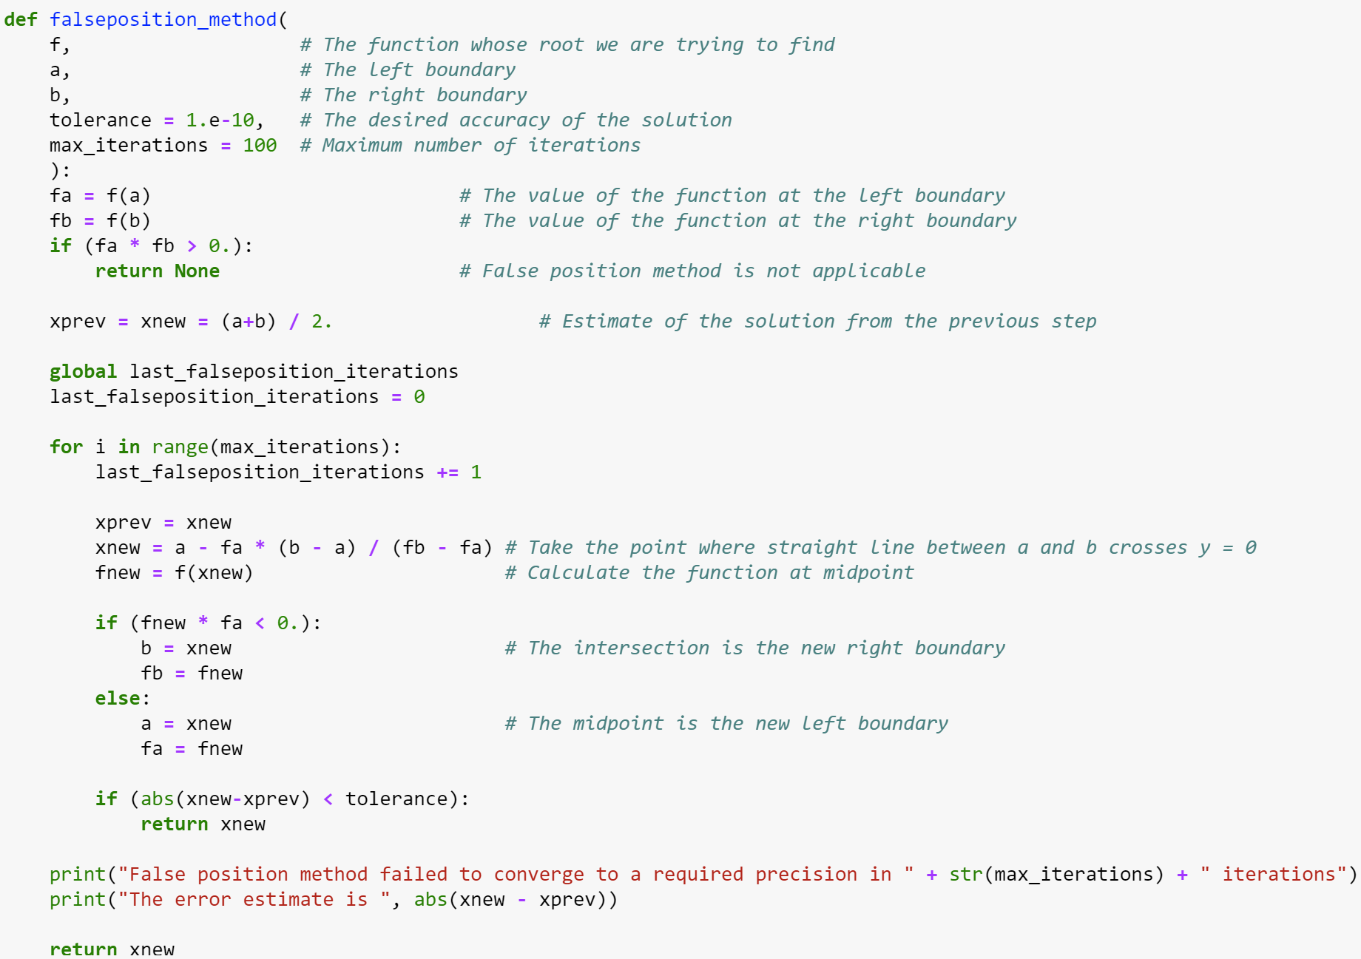
False position method

Slide 11
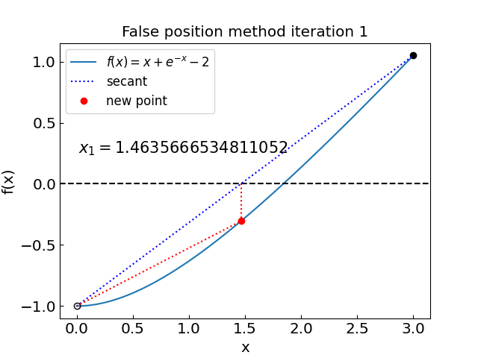
False position method

Slide 12
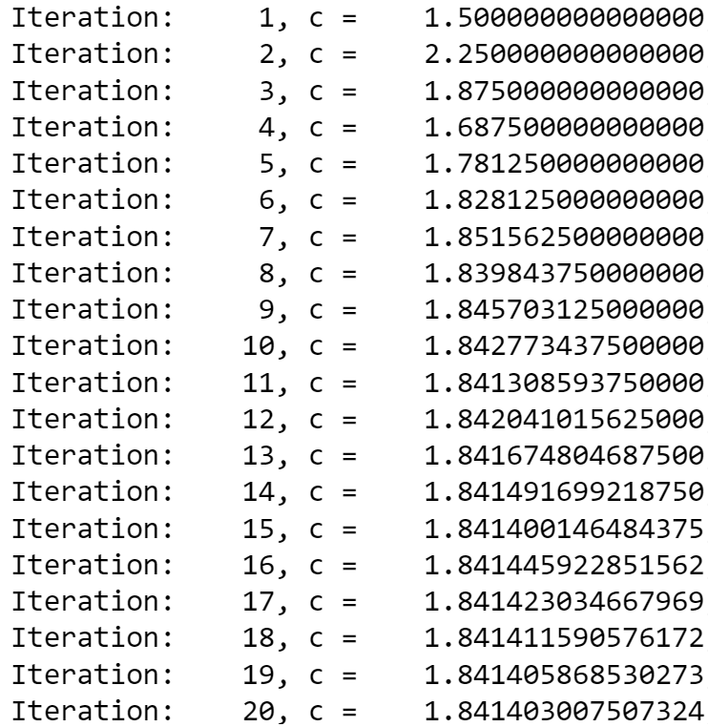
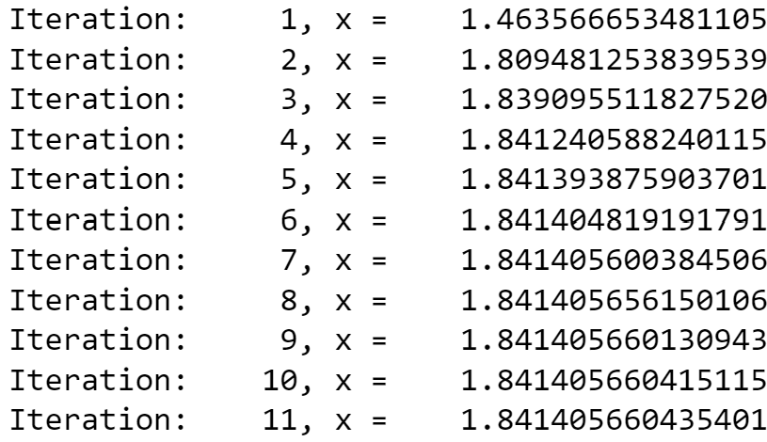
False position vs bisection (to 10 decimal digits)
Bisection method:
False position method:
…

Slide 13
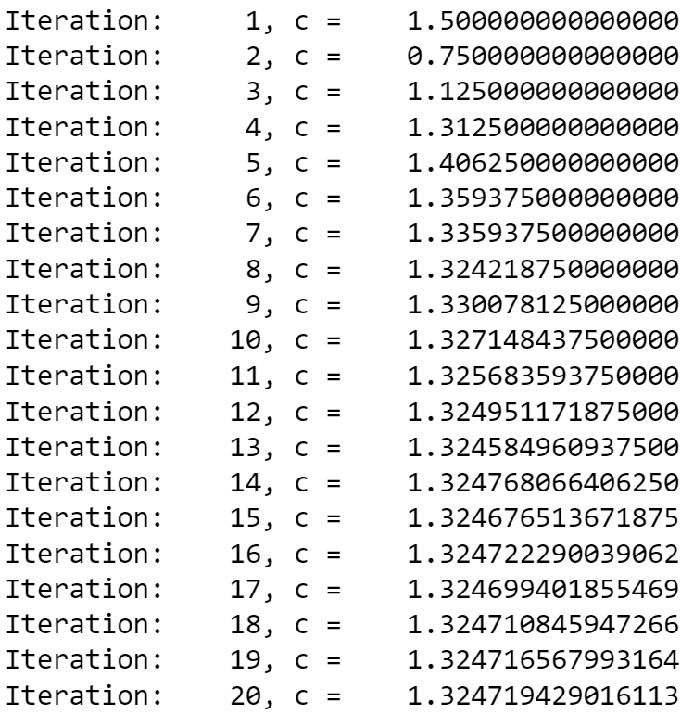
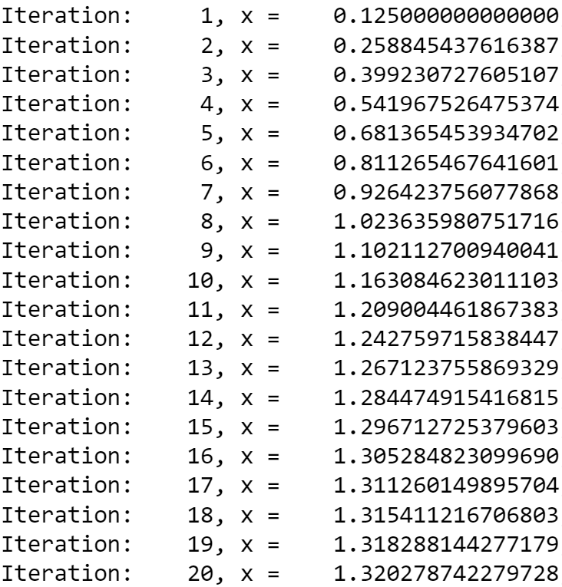
False position vs bisection: not always clear who wins
Bisection method:
False position method:
…
…

Slide 14
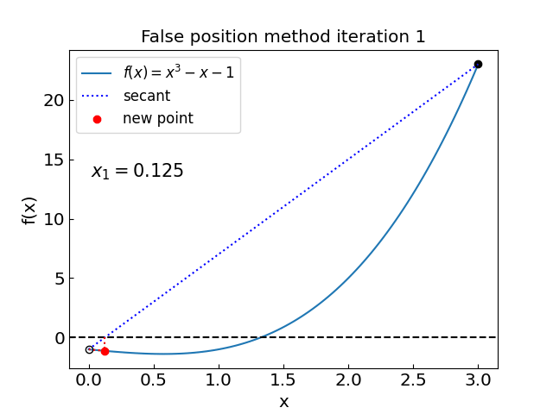
False position vs bisection: not always clear who wins
Bisection method:
False position method:
More advanced methods combine the two and add other refinements*
Ridders’ method
Brent method
see chapters 9.2, 9.3 of Numerical Recipes Third Edition by W.H. Press et al.

Slide 15
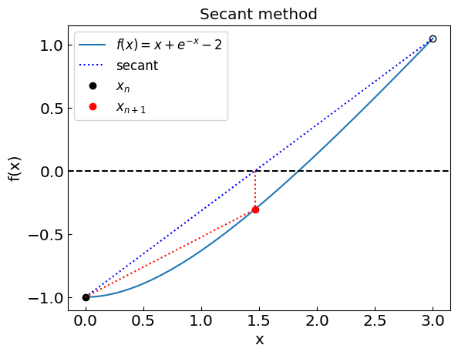
Secant method
Secant method: similar to false position, but the interval need not bracket the root
Always uses the last two points
vs
Typically “superlinear” convergence when works
Can still be slower than bisection or not converge at all (e.g. secant is parallel to y = 0 axis)

Slide 16
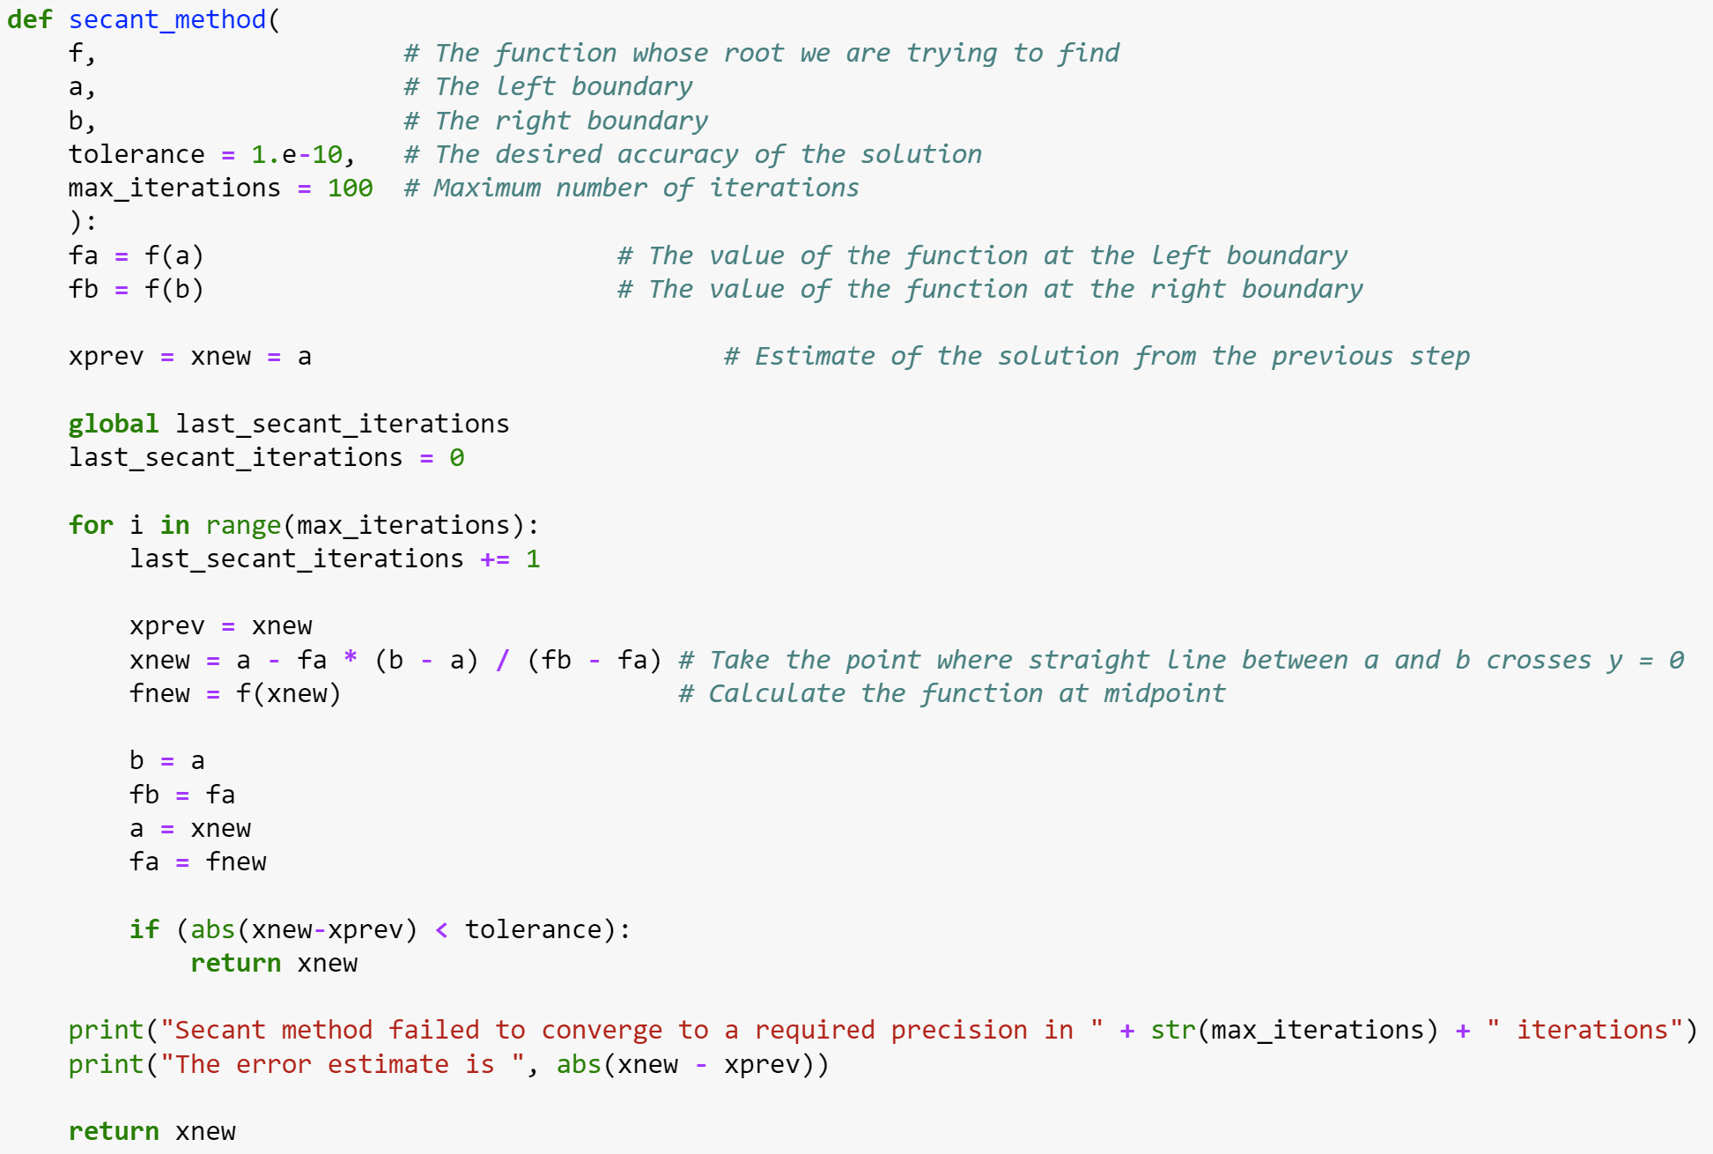
Secant method

Slide 17
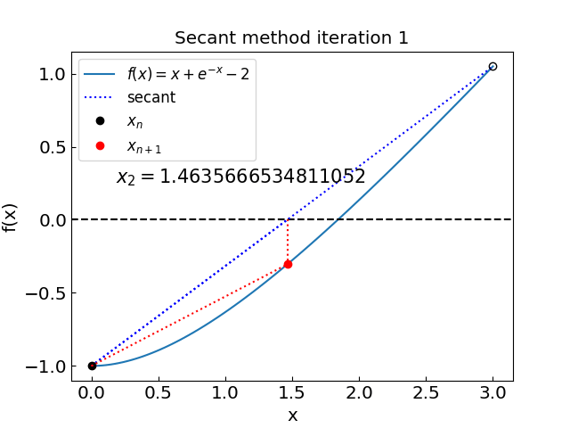
Secant method

Slide 18
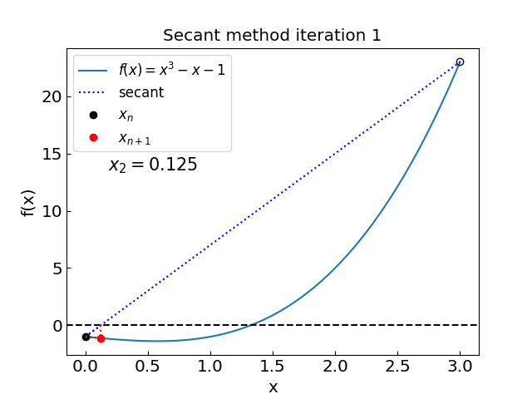
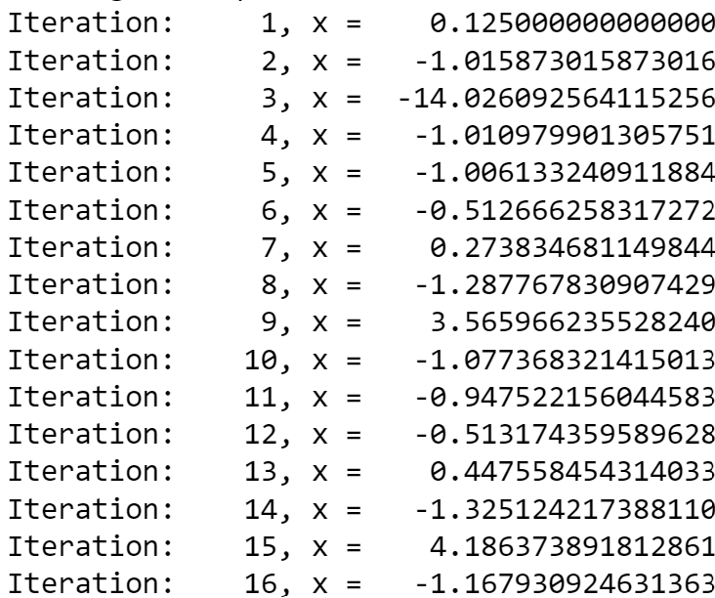
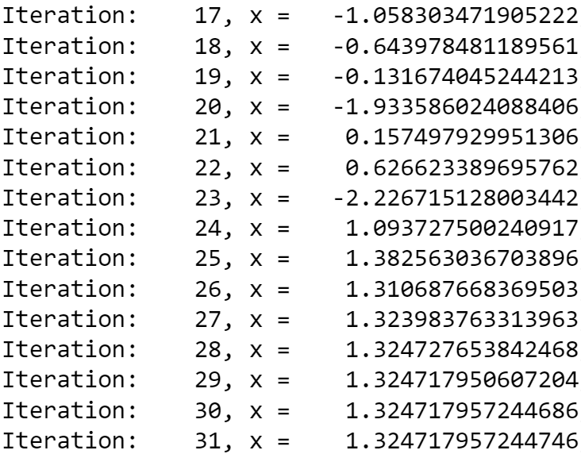
Secant method
Because the method does not bracket the root, it is not guaranteed to converge
In this case, it managed to recover

Slide 19
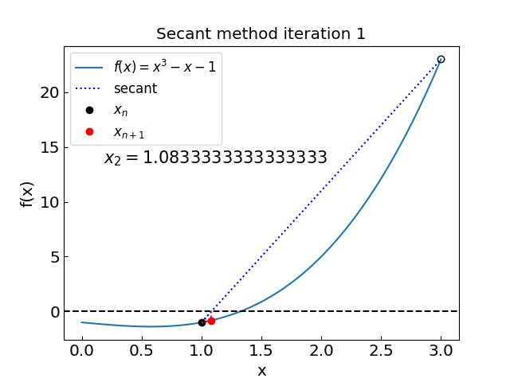
Secant method
Choose the initial interval as (1,3) instead of (0,3)

Slide 20
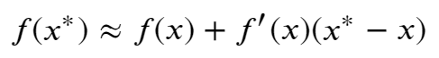
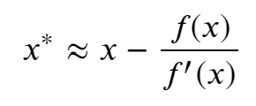
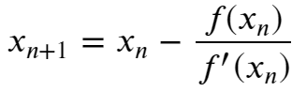
Newton-Raphson method
Newton-Raphson method:
Local method (uses only the current estimate to get the next one)
Requires the evaluation of derivative
Idea: Assume that a given point x is close to the root x* [f(x*)=0]
Then
and since f(x*) = 0 we have
Iterative procedure:
starting from initial guess x₀

Slide 21
Newton-Raphson method
“Quadratic” convergence when works
When we are close to f’ = 0 we have a problem

Slide 22
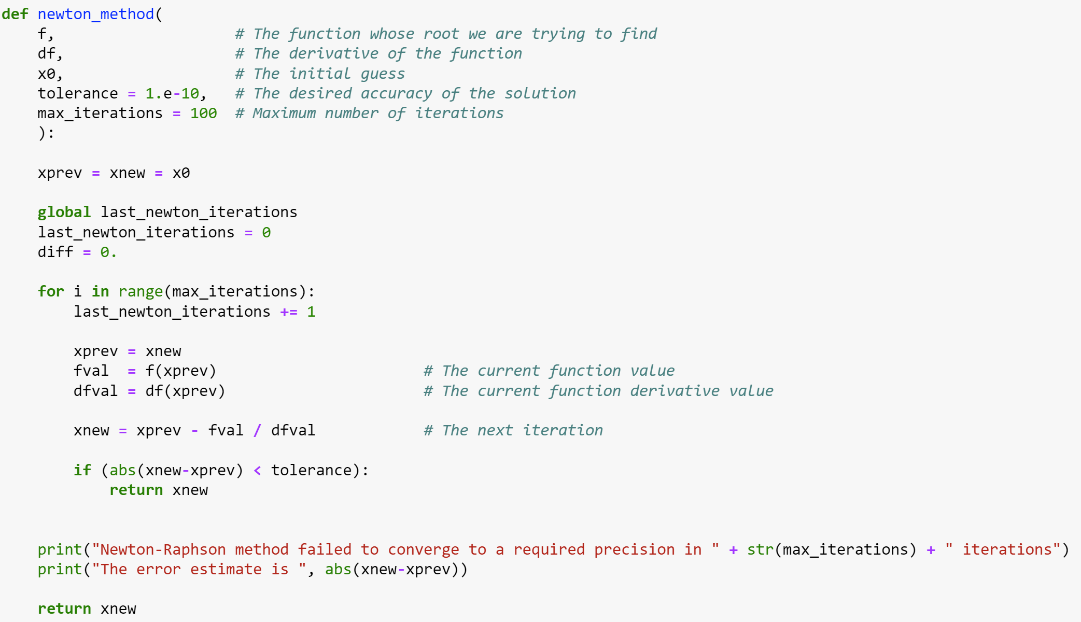
Newton-Raphson method

Slide 23
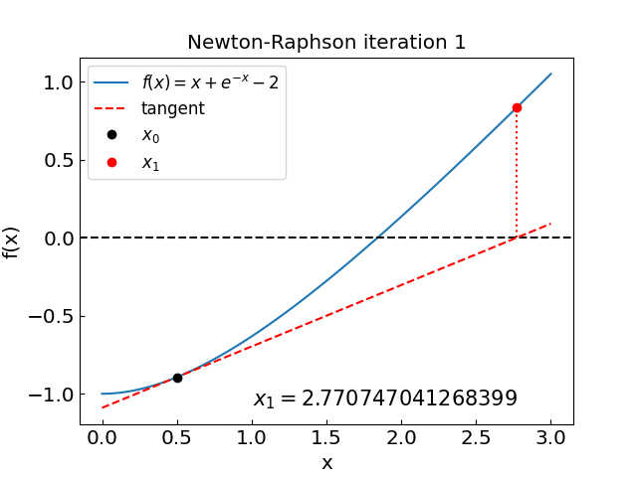
Newton-Raphson method

Slide 24
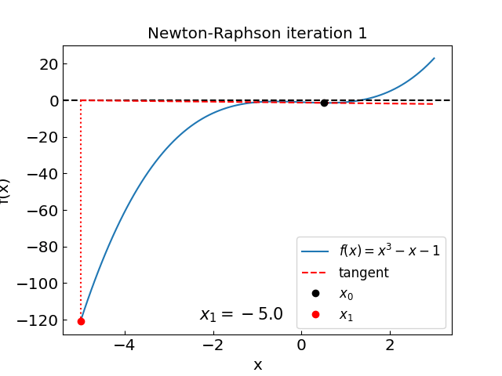
Newton-Raphson method: issues
Similar issue as with secant method; reason: f’ = 0 at x = 0.577…

Slide 25
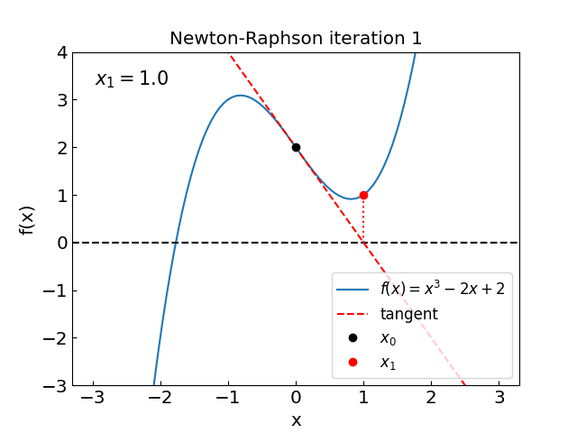

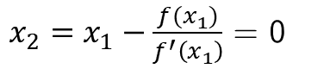
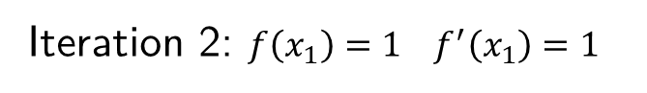
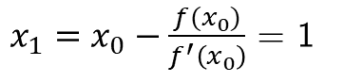
Newton-Raphson method: issues
Try finding the root of $f\left(x\right)=x^{3}−2x+2$ with an initial guess of $x_{0}=0$
Iteration 1: $f\left(x_{0}\right)=2, f^{′}\left(x_{0}\right)=−2$
$x_{1}=x_{0}−\frac{f(x_{0})}{f^{′}\left(x_{0}\right)}$ = 1
Iteration 2: $f\left(x_{1}\right)=1 f^{′}\left(x_{1}\right)=1$
$x_{2}=x_{1}−\frac{f(x_{1})}{f^{′}\left(x_{1}\right)}$ = 0
We are back to x₀!
The main issue is, again, we have points with f’ = 0 in the neighborhood

Slide 26
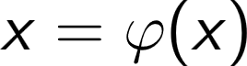
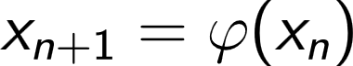
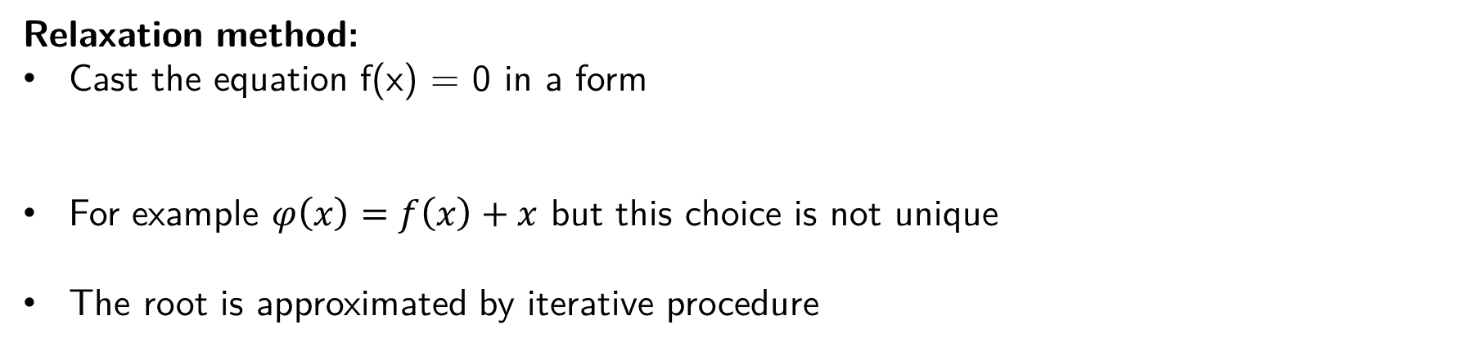
Relaxation method
Relaxation method:
Cast the equation f(x) = 0 in a form
For example $φ\left(x\right)=f\left(x\right)+x$ but this choice is not unique
The root is approximated by iterative procedure
Convergence criterion:

Slide 27
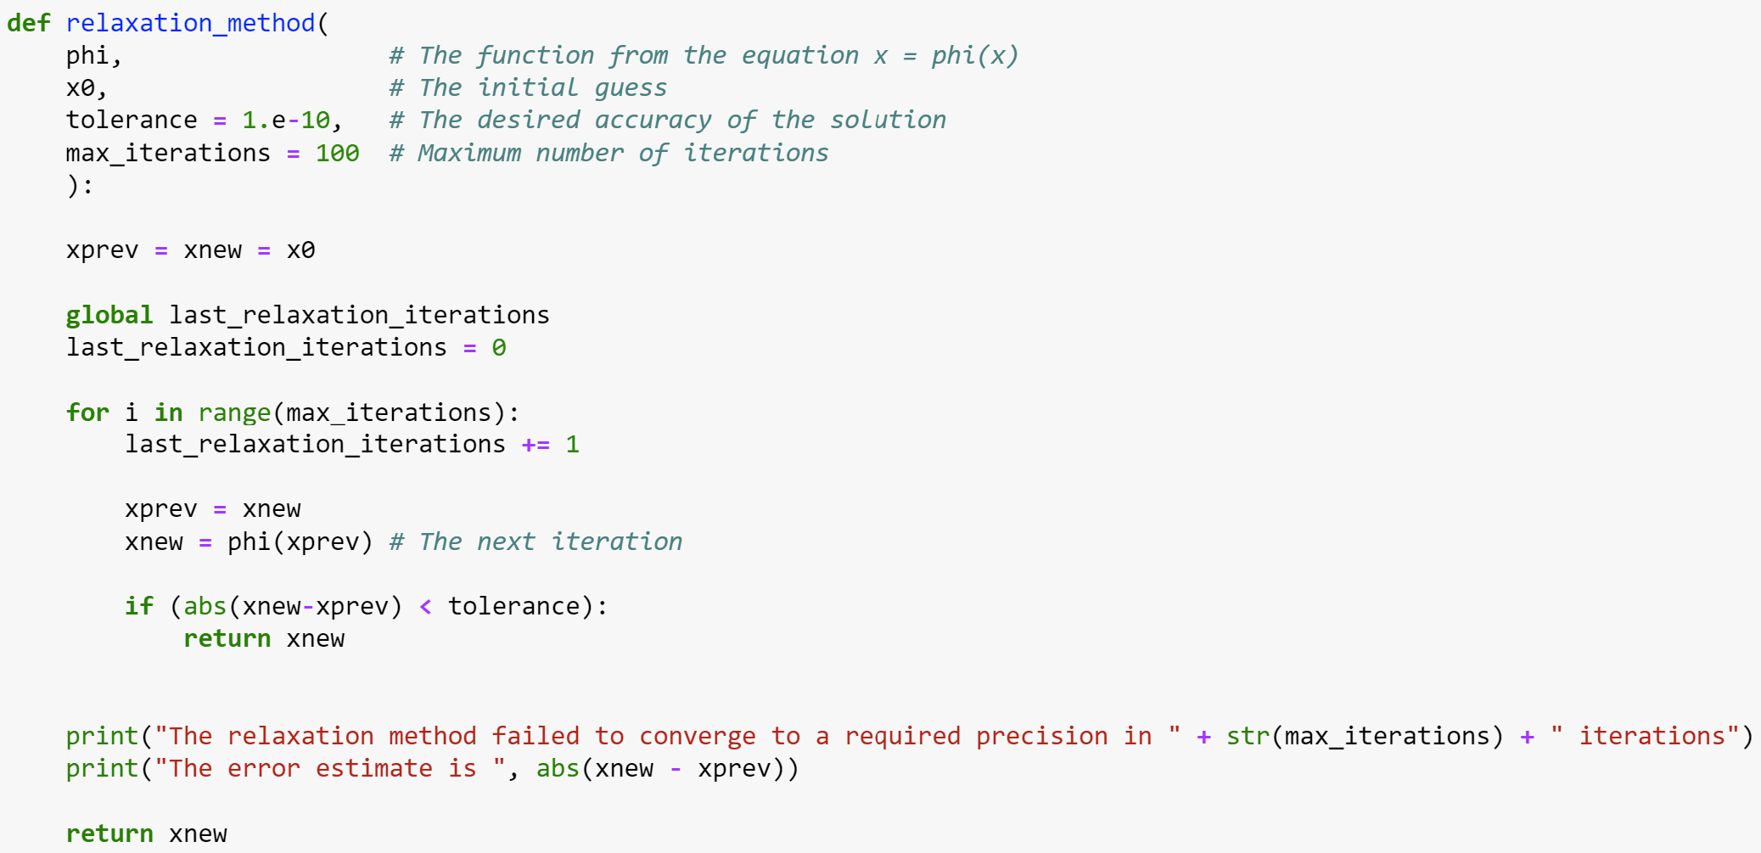
Relaxation method

Slide 28
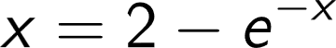
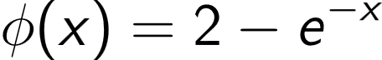
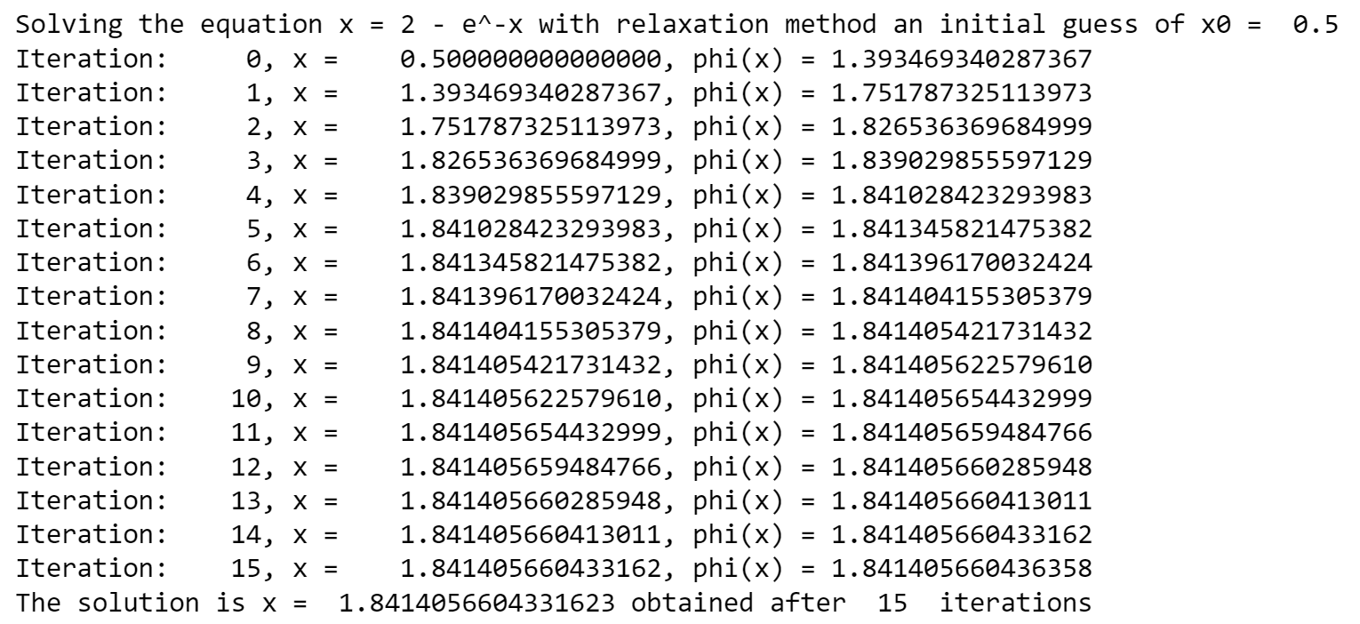

Relaxation method
as
i.e.
Starting with $x_{0}$=0.5 we have
Not as fast as Newton-Raphson but does not require evaluation of derivative

Slide 29
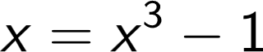
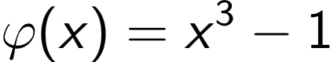
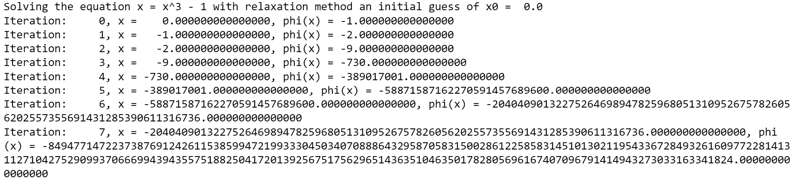
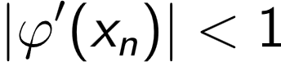

Relaxation method
as
i.e.
Starting with $x_{0}$=0.5 we have
Divergent!
violated [come up with better form of $φ(x)$?]
Reason:

Slide 30
Summary

Slide 31
Summary
Bisection method:
Guaranteed to converge with fixed rate
Need to bracket the root
Newton-Raphson method:
Very fast when converges
Can be sensitive to initial guess
May not converge if f’(x)=0
Requires evaluation of derivative at each step
False position method:
Guaranteed to converge
Can be faster than bisection but not always
Need to bracket the root
Relaxation method:
Simple to implement
Does not require derivative
Often does not converge
Secant method:
Typically faster than bisection and false position
May not always converge

